Slide 1




Kaggle : Competition 2024
Course Instructor:
Konda Reddy Mopuri
Team :
Sree Harsha CS21BTECH11042
Yash Shukla CS23MTECH14018
Course:
Deep Learning
AI5100

Slide 2
Index
Kaggle Overview
Challenges
Strategies
Model architecture
Hyperparameters
Regularisers
Other strategies
Datasets
Experimentation & Results
Conclusion

Slide 3

Kaggle Overview
Given standard multi-class classification task in Kaggle competition using deep learning
We started with Convolutional Neural Networks (CNNs) but transitioned to the ResNet and EfficientNetV2 architectures due to the dataset's size and the need for more complex models.
Despite facing challenges such as overfitting and fine-tuning difficulties, we experimented with various models and hyperparameters to achieve the best performance possible within the given time constraints.

Slide 4

Challenges
Model Selection: We initially used CNNs but later switched to ResNet due to dataset’s size and EfficientNetV2 for better performance.
Despite experimenting with various Resnet models like resnet101, resnet50, resnet34.
Overfitting became a significant challenge, especially with ResNet, requiring careful tuning of regularization techniques.
Because of time constraints Issue, Limited time for experimentation and model fine-tuning affected our ability to achieve optimal results.

Slide 5

Strategies
Transition to ResNet: ResNet was chosen for its effectiveness in handling deep networks, despite encountering some challenges with classification tasks.
Exploration of EfficientNetV2: EfficientNetV2 was explored for its promising capabilities, combining elements from ResNet50 and ResNeXt101.
Regularization Techniques: Various regularization techniques were employed to mitigate overfitting, including dropout and weight decay.

Slide 6
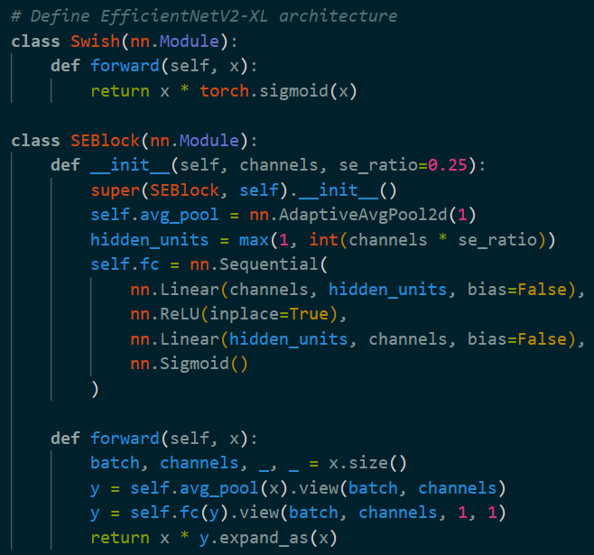
Architecture : EfficientNetV2-XL

Slide 7
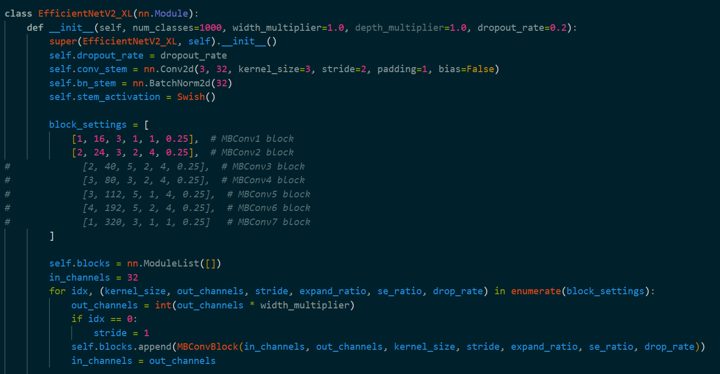
Architecture : EfficientNetV2-XL

Slide 8
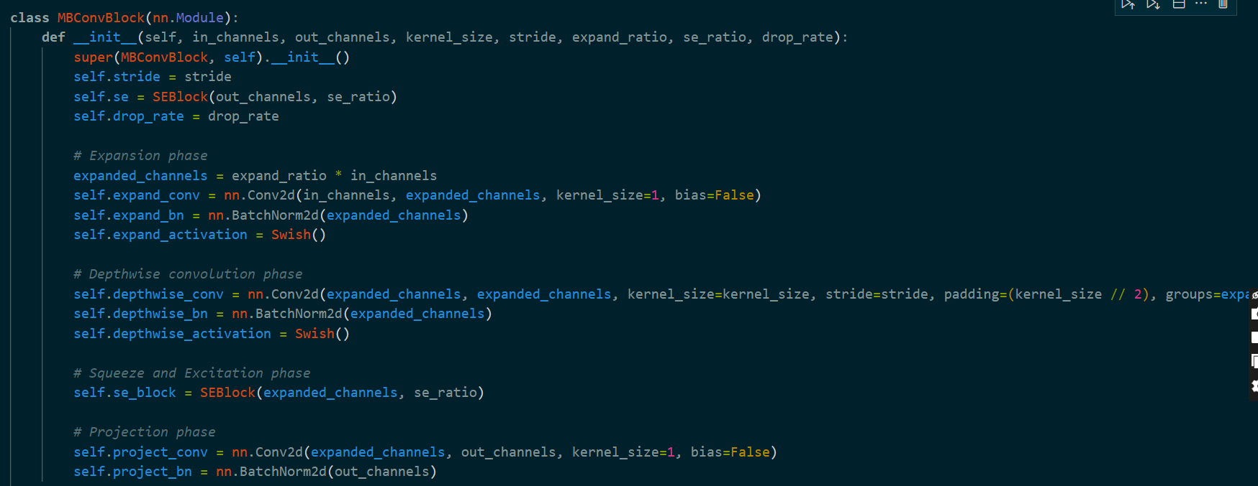
Architecture : EfficientNetV2-XL

Slide 9
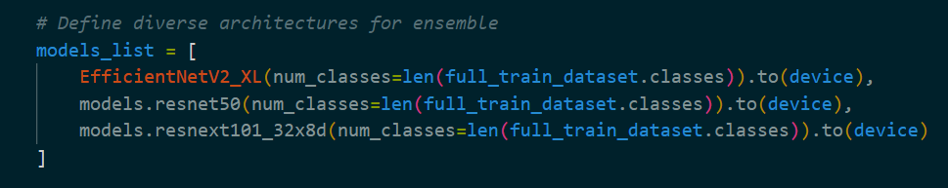
Architecture : EfficientNetV2-XL

Slide 10
Architecture : EfficientNetV2-XL

Slide 11
Architecture : EfficientNetV2-XL

Slide 12
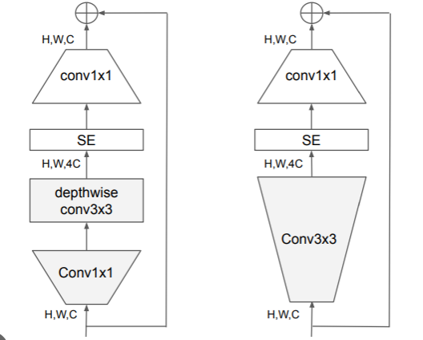
Architecture : EfficientNetV2-XL

Slide 13
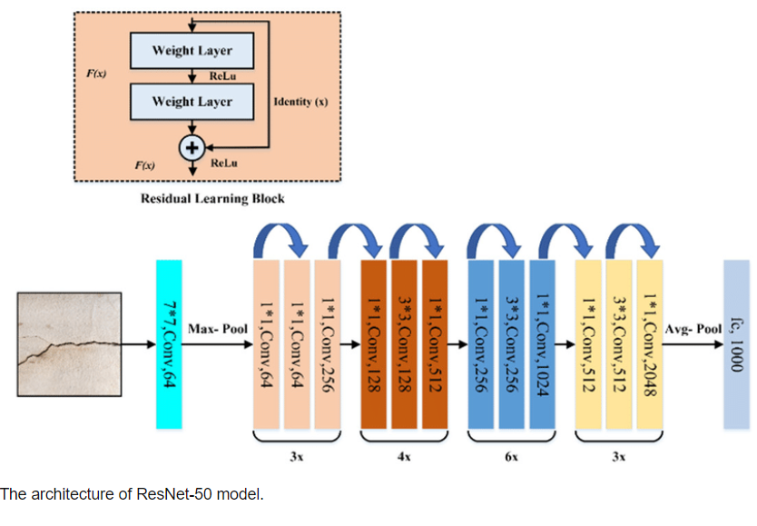
Architecture : ResNet

Slide 14
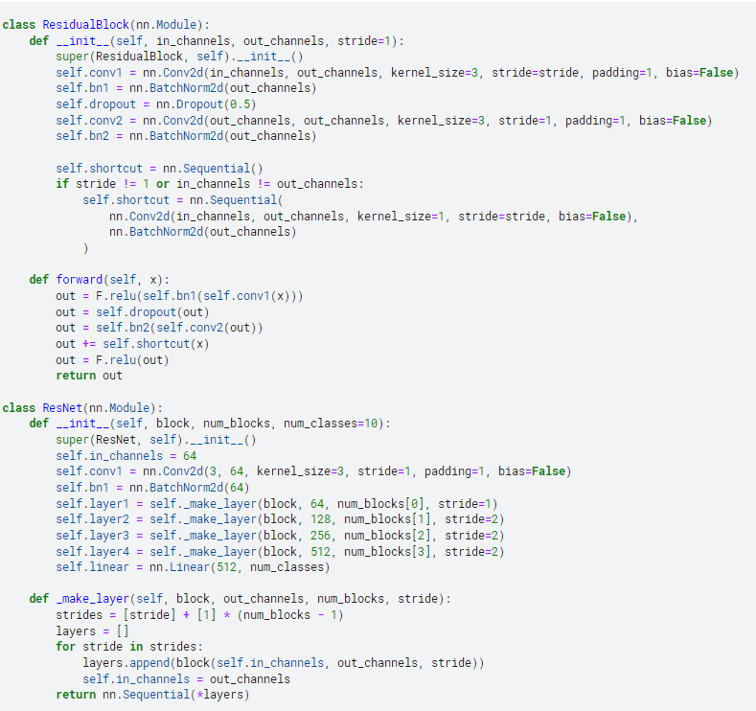
Architecture : ResNet

Slide 15
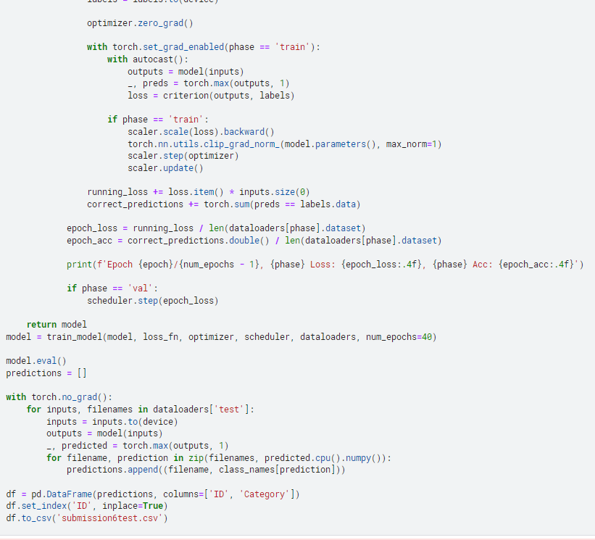
Architecture : ResNet

Slide 16
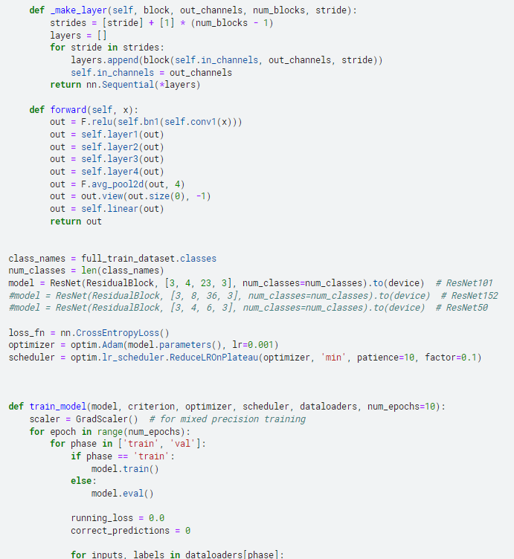
Architecture : ResNet

Slide 17
Dataset
Experimentation and Results
Challenges with EfficientNetV2-XL while experimenting which includes models EfficientNetV2_XL, ResNet50 and ResNeXt101_32x8d.
We encountered challenges in fine-tuning the models to achieve satisfactory performance levels.Unfortunately , due to time constraints ,futher adjustments were not possible before the deadline.
Achieved around 70% accuracy with ResNet
Limited time impacted the final performance of the models.
Despite efforts, further adjustments were not possible before the competition deadline.
Utilized the Kaggle competition dataset for training and evaluation.
Preprocessing and data cleaning steps were applied to prepare the dataset for model training.

Slide 18
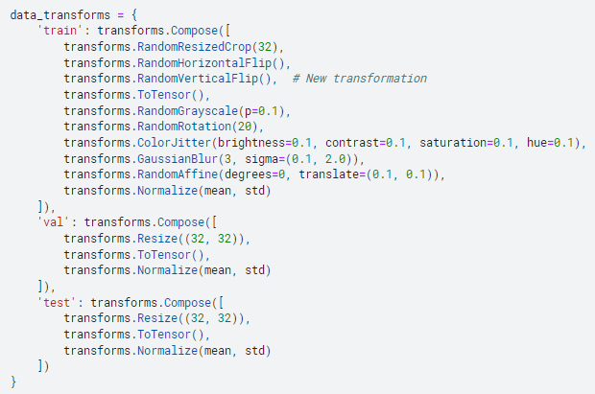
Preprocessing

Slide 19

References :
1] https://towardsdatascience.com/efficientnetv2-faster-smaller-and-higher-accuracy-than-vision-transformers-98e23587bf04
2] Original paper for EfficientNet : EfficientNetV2: Smaller Models and Faster Training
3] https://www.researchgate.net/figure/The-architecture-of-ResNet-50-model_fig4_349717475

Slide 20


Thank you

